Slide 1
OLAP Concepts
Part 1
<OLAP Concepts 101 Series>
Anupama Putcha
Notes:
Hello friends
I am Anupama, and today I shall take you through one of the key elements of a data-warehouse, called OLAP concepts. We have put together few slides that will explain all about it.
At the end of this session, you would get a fair idea of OLAP concepts and understand the different types of OLAP reporting.
The Target Audience is:
Team Rainbow (TRB) associates assigned to DW-BI practice after completion of Induction training
Associates newly joined to DW-BI practice with out prior DWH implementation experience
We shall begin our session with an overview of OLAP concepts.

Slide 2
Module Overview
On-Line Analytical Processing is a decision support software that allows the user to quickly analyze information that has been summarized into multidimensional views and hierarchies.
There are three main features of OLAP system :
Multidimensional Viewing – OLAP supports multidimensional model which consists of facts and dimensions also called as Star Schema.
Calculation Intensive Capabilities – Due to data is stored in facts and dimensions tables, it enables users to analyze data without much calculations.
Time Series analysis – Enables users to analyze data across time.
This Module will cover the details in three parts:
Part 1 – Importance of BI, DWH Architecture and different reporting types.
Part 2 – Data Access and Analysis, OLAP Introduction and Types
Notes:
‹#›
Online Analytical Processing is an approach to quickly answer multi-dimensional analytical queries.
The typical applications of OLAP are in for sales, marketingThe typical applications of OLAP are in for sales, marketing, business process managementThe typical applications of OLAP are in for sales, marketing, business process management (BPM), budgetingThe typical applications of OLAP are in for sales, marketing, business process management (BPM), budgeting and forecastingThe typical applications of OLAP are in for sales, marketing, business process management (BPM), budgeting and forecasting, financial reporting and similar areas.
The term OLAP was created as a slight modification of the traditional database term OLTP (Online Transaction Processing).
OLAP Concepts are categorized as:
.Understanding the need for data-warehouse, typical architecture and different ways of business reporting
.Understanding the data access and analysis
.Understanding the OLAP types
These details are covered in two parts. This presentation is part 1 of the series.

Slide 3
OLAP Objectives – Part Overview
Upon completion of this Part module you will be able to:
Appreciate the importance of Business Intelligence
Know the basic Data warehouse Architecture
Understand Different types of reporting
Notes:
‹#›
Before we begin with understanding OLAP concepts, it is important to understand the meaning of BI and a data warehouse.
Data warehouse is a repository of an organization's electronically stored data. Data warehouses are designed to facilitate reporting and analysis.
A data warehouse houses a standardized, consistent, clean and integrated form of data sourced from various operational systems in use in the organization, structured in a way to specifically address the reporting and analytic requirements.
The concept of data warehousing dates back to the late 1980s. In essence, the data warehousing concept was intended to provide an architectural model for the flow of data from operational systems to decision support environments.
Upon completion of this module you will be able to:
Appreciate the importance of Business Intelligence
Know the basic Data warehouse Architecture
Understand Different types of reporting.

Slide 4
OLAP Outline
Lesson 1 Importance of Business Intelligence
Lesson 2 Data warehouse Architecture
Lesson 3 Reporting Types
Notes:
‹#›
This module has 3 Lessons.
The first one is Importance of Business Intelligence.
Business Intelligence often aims to support better business decision-making. The term business intelligence is often used as a synonym for competitive intelligence.
The second one is Data warehouse Architecture.
The means to retrieve and analyze data, to extract, transform and load data, and to manage the data dictionary are considered some of the essential components of a data warehousing system.
The third one is Reporting Types.
Business intelligence tools are a type of application software are a type of application software designed to report, analyze and present data. The tools generally read data that have been previously stored, often, though not necessarily, in a data warehouse are a type of application software designed to report, analyze and present data. The tools generally read data that have been previously stored, often, though not necessarily, in a data warehouse or data mart.
The key general categories of business intelligence tools are:
SpreadsheetsSpreadsheets, Reporting and querying softwareSpreadsheets, Reporting and querying software - are tools that extract, sort, summarize, and present selected data ,OLAPSpreadsheets, Reporting and querying software - are tools that extract, sort, summarize, and present selected data ,OLAP Tools ,Digital Dashboards etc.
The different OLAP tools are : Cognos, Business Objects, Hyperion etc.

Slide 5
Importance of Business Intelligence
Notes:
Let us start with the Importance of Business Intelligence
In simple terms, refers to skills, technologies, applications and practices used to help a business acquire a better understanding of its commercial context.
Business Intelligence often aims to support better business decision-making. Thus a BI system can be called a decision support system (DSS).

Slide 6


Traditional DSS - Limitations
Spreadsheets and SQL are traditionally used as tool for analysis and decision making
Limitations of Traditional techniques
It is very difficult to define the aggregation levels, views in spreadsheets
SQL does not have a natural way of providing flexible view reorganizations that will transpose the data
Common analytic functions such as cumulative average and total are not supported in SQL
Extensive programming
Redundant reporting
Notes:
Traditional DSS Limitations
Integrated, Timely and Accurate view of business data
DWH & BI supports the features like:
Easy access to frequently needed data that is already tailor made for the purpose of decision making.
Each cell within a multidimensional structure contains aggregated data related to elements along each of its dimensions.
Aggregations are easily defined with pre-build hierarchies, that are ready to use with just drag-n-drop ease.
4. Queries are fast because the consolidation has already been done.
‹#›

Slide 7
Business Intelligence - Significance
Often Business Intelligent applications use data gathered from a data warehouse or a data mart.
A DWH houses a standardized, consistent, clean and integrated form of data sourced from various operational systems in use in the organization, structured in a way to specifically address the reporting and analytic requirements.
Data warehouses can become enormous with hundreds of gigabytes of transactions. As a result, subsets, known as "data marts," are often created for just one department or product line.
Notes:
In the 1970s and 1980s, computer hardware was expensive and computer processing power was limited. A medium-sized business typically operated a handful of large mainframe-based application systems that were designed for operational, data entry purposes. Information needs were addressed through paper reports. Report programs, however, were expensive to write and generally inflexible. A computer programmer was required to write the report programs. Fortunately, salaries for programmers were relatively low during this period.
In the 1980s, relational databases became the rage. Data was stored in tables with rows and columns, not unlike Excel Spreadsheets of today. Although relational databases were much more intuitive for end users, complex logic was often needed to join multiple tables to obtain the information that was needed. Although it was possible for end users to write simple reports, the queries were often inefficient and had to be run after normal business hours, in order not to impact online transactions.
In the late 1980s, many businesses migrated from mainframe computers to client servers. Business people were assigned a personal computer. Office applications such as MicroSoft World, Excel and Access became popular. The personal computer empowered end users and allowed them to develop their own applications and present data in a manner that was meaningful to them, such as in grid or graph format. Excel spreadsheets could easily be tweaked as business needs changed, without the assistance from the IT department. Unfortunately, corporate data remained centralized and was generally not directly accessible to end users.
The need for improved business intelligence and data warehousing accelerated in the 1990s. During this period, huge technological changes occurred and competition increased as a result of free trade agreements, globalization, computerization and networking.
By the end of the millennium, businesses discovered that the number of application systems and databases had multiplied, that their systems were poorly integrated and that their data was inconsistent across the systems. More importantly, businesses discovered that they had lots of fragmented data, but not the integrated information that was required for critical decision making in a rapidly changing, competitive, global economy.
Companies began building Data Warehouses to consolidate data from disparate databases and to better support their strategic and tactical decision making needs.
There are many business drivers in play today that are motivating companies to establish data warehouses. Some of them are :
Current and Accurate Information
Rapidly Changing Information Needs
Customer Service Excellence
New Service Delivery Channels
Single Version of the Truth
‹#›

Slide 8
Business Intelligence - Future
In a 1958 article, IBM researcher Hans Peter Luhn used the term business intelligence. He defined intelligence as: The ability to apprehend the inter-relationships of presented facts in such a way as to guide action towards a desired goal.
Business Intelligence uses concepts and methods to improve business decision making by using fact-based support systems
BI technologies provide historical, current, and predictive views of business operations. Common functions of Business Intelligence technologies are reporting, OLAP, analytics, data mining, business performance management and predictive analytics.
Business Intelligence often aims to support better business decision-making. Thus a BI system can also be referred as a decision support system.
Notes:
A 2009 Gartner paper predicted these developments in business intelligence market .
In 2009, collaborative decision making will emerge as a new product category that combines social software with business intelligence platform capabilities.
By 2010, 20 per cent of organizations will have an industry-specific analytic application delivered via software as a service as a standard component of their business intelligence portfolio.
Because of lack of information, processes, and tools, through 2012, more than 35 per cent of the top 5,000 global companies will regularly fail to make insightful decisions about significant changes in their business and markets.
‹#›

Slide 9
BIDW Architecture
Notes:
Now we come to the second part of the module – Data Warehouse Architecture.
‹#›

Slide 10
Data warehouse Architecture
Architecture, in the context of an organization's data warehousing efforts, is a conceptualization of how the data warehouse is built.
Data warehouses are generally batch updated at the end of the day, week or some period. Its contents are typically historical and static and may also contain numerous summaries.
Notes:
There is no right or wrong architecture, rather multiple architectures exist to support various environments and situations.
The worthiness of the architecture can be judged in how the conceptualization aids in the building, maintenance, and usage of the data warehouse.
A data warehouse architecture consists of the following interconnected layers:
Operational database layer
The source data for the data warehouse - An organization's Enterprise Resource Planning systems fall into this layer.
Data access layer
The interface between the operational and informational access layer - Tools to extract, transform, load data into the warehouse fall into this layer.
Metadata layer
The data directory - This is usually more detailed than an operational system data directory. There are dictionaries for the entire warehouse and sometimes dictionaries for the data that can be accessed by a particular reporting and analysis tool.
Informational access layer
The data accessed for reporting and analyzing and the tools for reporting and analyzing data - Business intelligence tools fall into this layer. And the Inmon-Kimball differences about design methodology, discussed later in this article, have to do with this layer.

Slide 11
A typical data warehouse
A typical data warehouse consists of …
Source data
Staging area
Warehouse
Data Marts
Reports
Analytical environment
Notes:
‹#›
Technically a Data warehouse is defined as a Subject Oriented, Time Variant, Non-Volatile, Integrated collection of data, specifically structured for information access and reporting.
Subject Oriented: Data is based on subjects like Sales, Finance makes it subject oriented.
Time Variant: Data is present in the DWH for a particular period of time.
Non- Volatile: Once entered into the DWH, the data should not change.
Integrated: Data from disparate sources are to be put in a DWH in a consistent format.

Slide 12

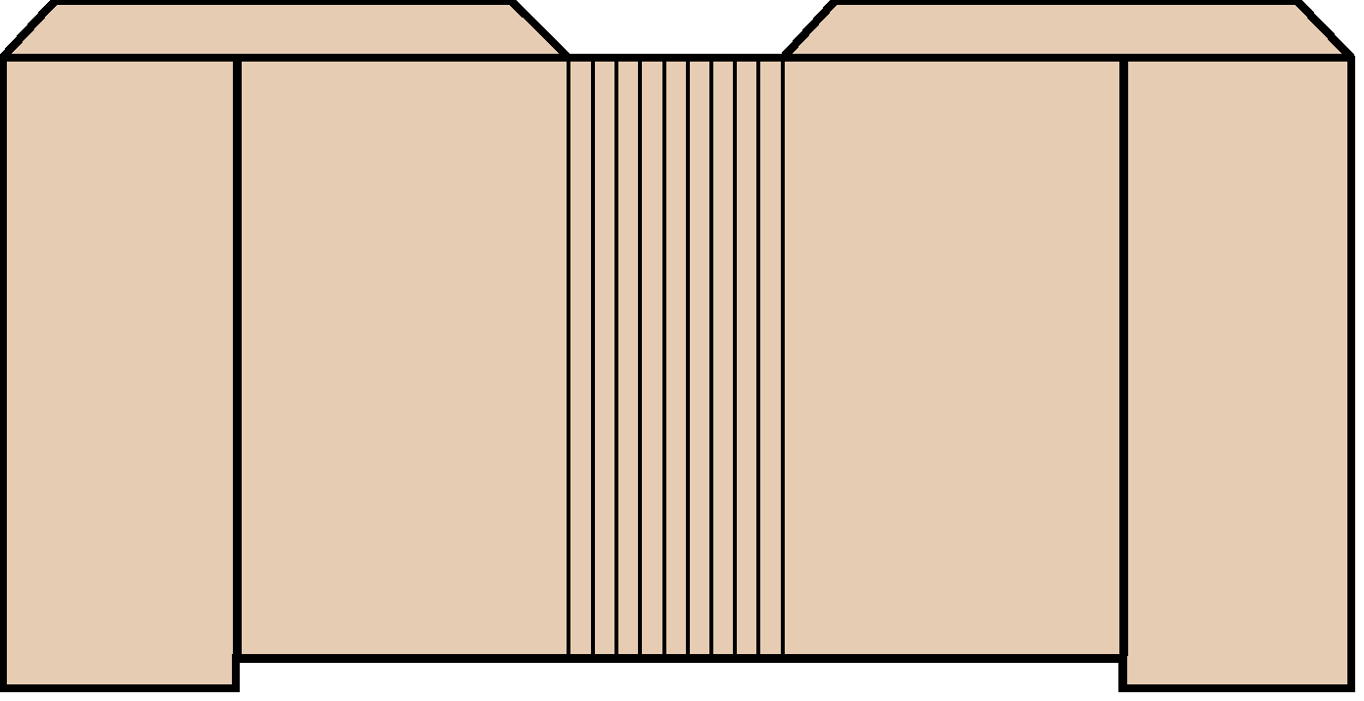



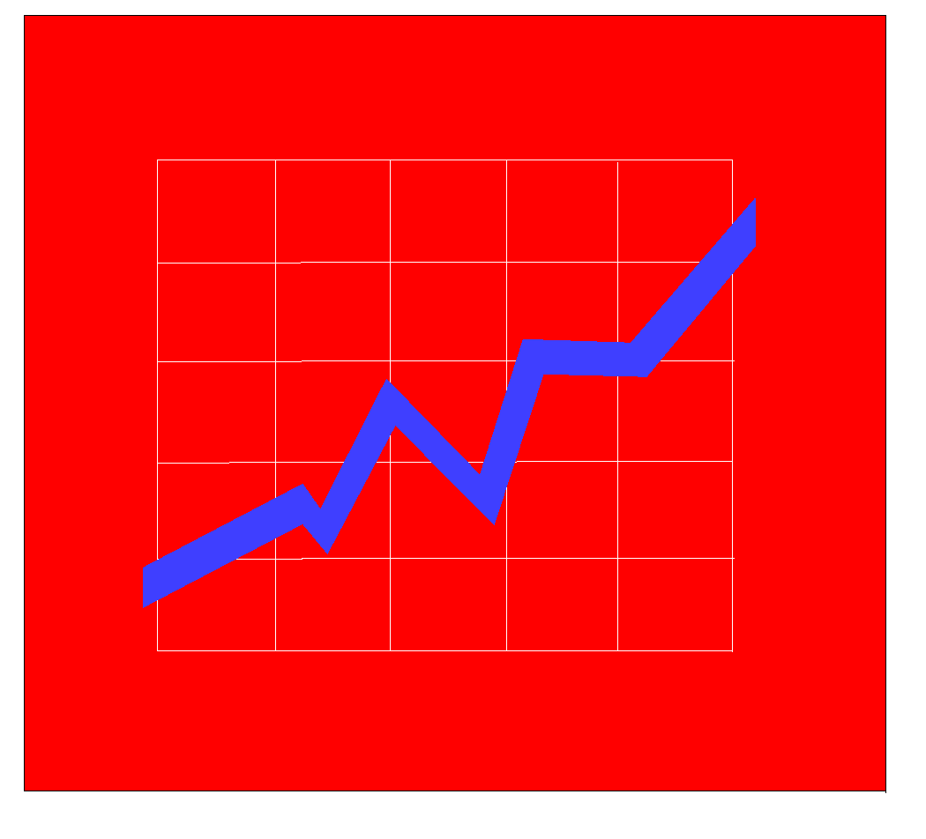
Warehouse Architecture - A
EIS /DSS
Metadata
Select
Extract
Transform
Integrate
Maintain
Query Tools
Data
Warehouse
OLAP/ROLAP
Operational
Systems/Data
Web Browsers
Middleware/
API
Data
Preparation
Data Mining
Enterprise Data Warehouse
Notes:
One possible simple conceptualization of a data warehouse architecture consists of the following interconnected layers:
Source data: This is the raw data (or dirty data as it is called) from multiple sources like transaction data, look up files, Mapping tables. Part of the data to be used for analysis will be extracted from this source.
Data Preparation or Staging area: This is the place where all the data cleansing is done. Unwanted data is deleted / data formatting is done wherever needed (like date formats, Location names Aliases, etc).
The Data Warehouse Staging Area is temporary location where data from source systems is copied. A staging area is mainly required in a Data Warehousing Architecture for timing reasons. In short, all required data must be available before data can be integrated into the Data Warehouse.
Due to varying business cycles, data processing cycles, hardware and network resource limitations and geographical factors, it is not feasible to extract all the data from all Operational databases at exactly the same time.
Warehouse: Final data that is cleansed and formatted goes to the Data warehouse.
Metadata (meta data, or sometimes metainformation) is "data about data", of any sort in any media. Metadata is text, voice, or image that describes what the audience wants or needs to see or experience.
Metadata is important because it aids in clarifying and finding the actual data.
The metadata information about the DWH can be stored within the same database in additional tables or as a separate information source.
Source of the Figure: Prepared Manually, Individual items taken from various sources

Slide 13
Warehouse Architecture - B
Metadata
EIS /DSS
Data Mart
Select
Extract
Transform
Integrate
Maintain
Metadata
Query Tools
Data Mart
OLAP/ROLAP
Metadata
Operational
Systems/Data
Web Browsers
Data Mart
Middleware/
API
Data
Preparation
Data Mining
Single Department Data Mart
Notes:
Here the Data warehouse Metadata layer is broken down into Data Marts and developed individually for each department specific information.
Data Marts: A subset of a data warehouse for a single department or function. This is designed to focus on specific business functions for a specific community within an organization. Data marts can also be created to separate an authorized data subset selectively.
ETL (Extract Transform Load) jobs extract data from the Data Warehouse and populate one or more Data Marts for use by groups of decision makers in the organizations.
The Data Marts can be Dimensional (Star Schemas) or relational, depending on how the information is to be used and what "front end" Data Warehousing Tools will be used to present the information.
The data mart are used by the end user to generate reports and analytics.
Reports – This area supports the decision making team and executive to have their required business insight. Reports are developed on top of the warehouse data storage layer using various reporting tool
Analytical environment - This provides the sophisticated and analytical environment to business analyst and senior executives to analyze their business performance in various angle as they wish. Lot of intuitive analytical operations such as Ad-hoc analysis, What-if analysis, Marker basket analysis, data mining etc, being performed here.
Middleware is computer software is computer software that connects software components or applications. The software consists of a set of services that allows multiple processes running on one or more machines to interact.
It includes web serversIt includes web servers, application servers, and similar tools that support application development and delivery.
Middleware sits "in the middle" between application softwareMiddleware sits "in the middle" between application software that may be working on different operating systemsMiddleware sits "in the middle" between application software that may be working on different operating systems. It is similar to the middle layer of a three-tier single system architecture
Examples include EAIExamples include EAI software, telecommunications software, transaction monitors, and messaging-and-queueing software.
Source of the Figure: Prepared Manually, Individual items taken from various sources

Slide 14
Warehouse Architecture - C
Data
Marts
EIS /DSS
Metadata
Select
Extract
Transform
Integrate
Maintain
Query Tools
Data
Warehouse
OLAP/ROLAP
Web Browsers
Operational
Systems/Data
Operational Data Store
Middleware/
API
Data
Preparation
Data Mining
Multi-tiered Data Warehouse
Notes:
This is the case when a central Data warehouse is created and then divided into Data marts for specific department / business line.
This maybe a result when the centralized data warehouse is very huge and slows down the due to huge volumes.
Each Data Mart can contain different combinations of tables, columns and rows from the Enterprise Data Warehouse. For example, a business unit or user group that doesn't require a lot of historical data might only need transactions from the current calendar year in the database.
Some Data Mart might need to be refreshed from the Data Warehouse daily.
Decision makers don't access the Data Warehouse directly. This is done through various front-end Data Warehouse Tools that read data from subject specific Data Marts.
Source of the Figure: Prepared Manually, Individual items taken from various sources

Slide 15
Reporting Types
Notes:
The third part of the module deals with the different Reporting Types.
Reporting is a category of data access solution in which the information is presented in the form of reports
Companies are data rich but information poor
Transaction systems generate huge volume of data
Need to turn this data into actionable information
Reporting tools are also referred as Query and reporting tools.
‹#›

Slide 16
Type of Reporting
Transaction Systems Reporting
Replicated OLTP Reporting
Data Mart Reporting
Enterprise Data Warehouse Reporting
Notes:
‹#›
Transaction Systems Reporting also known as Online transaction processing reporting, or OLTP, refers to a class of systems that facilitate and manage transaction-oriented applications, typically for data entry and retrieval.
OLTP systems are designed so processing of day-to-day transactions is performed efficiently and the integrity of the transactional data is preserved.
Replicated OLTP Reporting: as the name suggests, can be regarded as the duplicate copy of the OLTP that operated offline for reporting purposes.
Data Mart Reporting: Data mart Reporting is done using the analytical data stores designed to focus on specific business functions for a specific community within an organization.
Enterprise Data Warehouse Reporting: A reporting system designed to support decision making in an organization.
Data warehouses are generally batch updated at the end of the day, week or some period. Its contents are typically historical and static and may also contain numerous summaries.

Slide 17
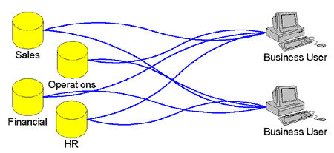
Transaction Systems Reporting
Reports are created from the transaction systems
Reporting Tool has a native connectivity to
The OLTP database or
A generic data access protocol such as ODBC, JDBC or OLE DB is made use of
This type of reporting is needed for time-sensitive reporting
E.g. those reports which need to be up to date with the transactions occurring within the last 24 hours
Notes:
‹#›
Reports directly access the transactional system for reporting purposes. Reports more likely contain the transition details of a customer for a Bank, transactional data of selling a product in a day etc. This report needs more real time data to support.
Advantage:
The primary advantage to reporting from OLTP is speed to information (Latest data)
Disadvantages:
The data accessed in the OLTP system is the ‘raw’ transaction data and is often ‘dirty’
Organization of the data is not intuitive to a business user
Historical data is not available
When used for Reporting, the transaction system performance is affected
Source of the Figure: Prepared Manually, Individual items taken from various sources

Slide 18
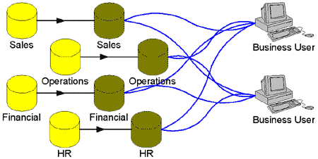
Replicated OLTP Reporting
Replication to the offline data store is done by
Transaction logs
Database replication
Batch files
Notes:
‹#›
This form of reporting is an alternative to Transaction System Reporting.
Here an offline data store is created that is a replica of the production data store. This data store services the reporting needs of the end user. Purpose of having this replicated environment is not to disturb transactional system more frequently while you need operational reporting for your data warehouse
Advantages:
This reduces the load on the OLTP,
Gives better Fault-tolerance, Scalability and Local Access.
This reporting will be done in a pseudo real time environment.
Disadvantages:
Duplication of data.
Needs more space to create additional data store.
Source of the Figure: Prepared Manually, Individual items taken from various sources

Slide 19
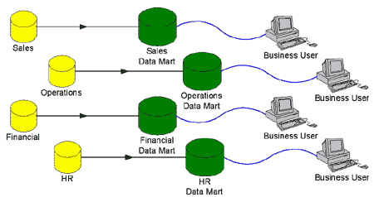
Data Mart Reporting
Another method is to feed transaction data to a system optimized for reporting (data mart)
Notes:
‹#›
Caters to a single department or function, usually oriented to a specific purpose that may be distributed to support business needs. For this reason it can also be called as a subset of data warehouse.
Data marts are modeled in a structured way and integrated with quality assured from business / transactional rule embedded.
Data mart is also created for the following reasons:
Easy creation and access to frequently needed data.
2. Creates collective view by a group of users
3. Improves end-user response time and lower implementation cost then a full data warehouse
6. Potential users are more clearly defined in Marts than in DWH.
Advantages:
Data marts are optimized for efficient reporting
The data organization is intuitive so the business user will be able to browse the data with little or no training
Historical information will be stored
Use of data cleansing tools can ensure data quality
Disadvantages:
The primary limitation of a data mart approach is scalability.
Data marts focus on a single department such as sales, inventory, financial analysis or production.
Source of the Figure: Prepared Manually, Individual items taken from various sources

Slide 20
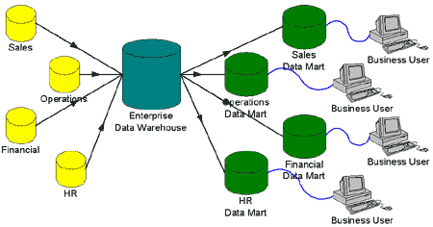
Enterprise Data Warehouse Reporting
An enterprise data warehouse (EDW) is designed
To combine data from multiple OLTP systems
To provide consolidated and cleansed data to an array of data marts
Notes:
‹#›
Data from the various production databases are copied to the data warehouse so that queries can be performed without disturbing the performance or the stability of the production systems.
The data in the Data Warehouse is:
1. Subject-oriented
The data in the data warehouse is organized so that all the data elements relating to the same real-world event or object are linked together.
2. Non-volatile
Data in the data warehouse is never over-written or deleted - once committed, the data is static, read-only, and retained for future reporting.
3. Integrated
The data warehouse contains data from most or all of an organization's operational systems and this data is made consistent.
Source of the Figure: Prepared Manually, Individual items taken from various sources

Slide 21
Query and Reporting tools
Query and reporting tools are used for providing Reporting Solutions
One type of classification
Ad hoc Query Tool
Managed Query Tool
Notes:
‹#›
Query and Reporting tools are a type of application software designed to report, analyze and present data.
These tools can extract, sort and summarize the selected data before presenting.

Slide 22
Query and Reporting tools
Ad hoc Query Tool
Lets the user create a SQL query in a graphical environment
Supports limited complex analysis
Connects to external data sources through ODBC
Examples :
Microsoft Access
MS Query
Managed Query Tool
Has a semantic layer to hide database complexity from the user
Presents the user with a semantic layer in the business terms
Has security management, usage limits, report sharing
Examples :
Oracle Discoverer
Business Objects
Cognos Impromptu
Notes:
‹#›
Ad hoc queries are one time or "spur of the moment" query not meant to be repeated time and time again.
They are good "What if", proof of concept and investigation queries to either answer a one time question or see if more investigation needs to be done.
Managed Queries are created once by specified group of users and re-used again and again by business users to get the up-to-date information from the database.
Transaction/OLTP Reporting - Proprietary reporting tools e.g., Oracle Reports, Ad hoc Query tools
Replicated OLTP Reporting - Proprietary reporting tools e.g., Oracle Reports, Ad hoc Query tools
Data Mart Reporting - Ad hoc Query tools, Managed Query tools
Enterprise Data Warehouse Reporting - Ad hoc Query tools, Managed Query tools

Slide 23
Quiz
Notes:
‹#›
© 2009 Wipro Ltd – Internal & Restricted
‹#›

Slide 24
Question 1
Data warehouse is a <Fill in the blanks> collection of data, specifically structured for information access and reporting. Mark the incorrect answer:
Subject Oriented
Time Variant
Non-Volatile
Segregated
Answer: D
Notes:
‹#›
© 2009 Wipro Ltd – Internal & Restricted
‹#›

Slide 25
Question 2
2. Traditional Decision Making tools include:
BI Reporting
Excel
Analytical reporting
SQL
Answer: B and D
Notes:
‹#›
© 2009 Wipro Ltd – Internal & Restricted
‹#›

Slide 26
Question 3
3. In a typical data warehouse architecture the Data Marts are expected to be created after:
Source data
Staging
Data warehouse
reports and analytics
Answer: C
Notes:
‹#›
© 2009 Wipro Ltd – Internal & Restricted
‹#›

Slide 27
Question 4
4. Historical data is not available with which of the following options.
Data Mart Reporting
Transaction Systems Reporting
Replicated OLTP Reporting
Enterprise Data Warehouse Reporting
Answer: B and C
Notes:
‹#›
© 2009 Wipro Ltd – Internal & Restricted
‹#›

Slide 28
Question 5
5. Managed Query tools can be used on.
Transaction/OLTP Reporting
Data Mart Reporting
Replicated OLTP Reporting
Enterprise Data Warehouse Reporting
Answer: B and C
Notes:
‹#›
© 2009 Wipro Ltd – Internal & Restricted
‹#›

Slide 29
References
Notes:
‹#›
© 2009 Wipro Ltd – Internal & Restricted
‹#›

Slide 30
References
Publications
Courses
The OLAP Solutions – Building Multidimensional Information Systems Second Edition by Erik Thomsen, Wiley dream tech India Pvt. Ltd. 2002 ISBN 81-265-0275-4
URL’s
Training Programs
Tek-tips reporting solutions forum
http://www.dmreview.com/
http://www.dwinfocenter.org

Slide 31
Thank You
Anupama Putcha
Senior Software Engineer
anupama.putcha@wipro.com

